Slide 1

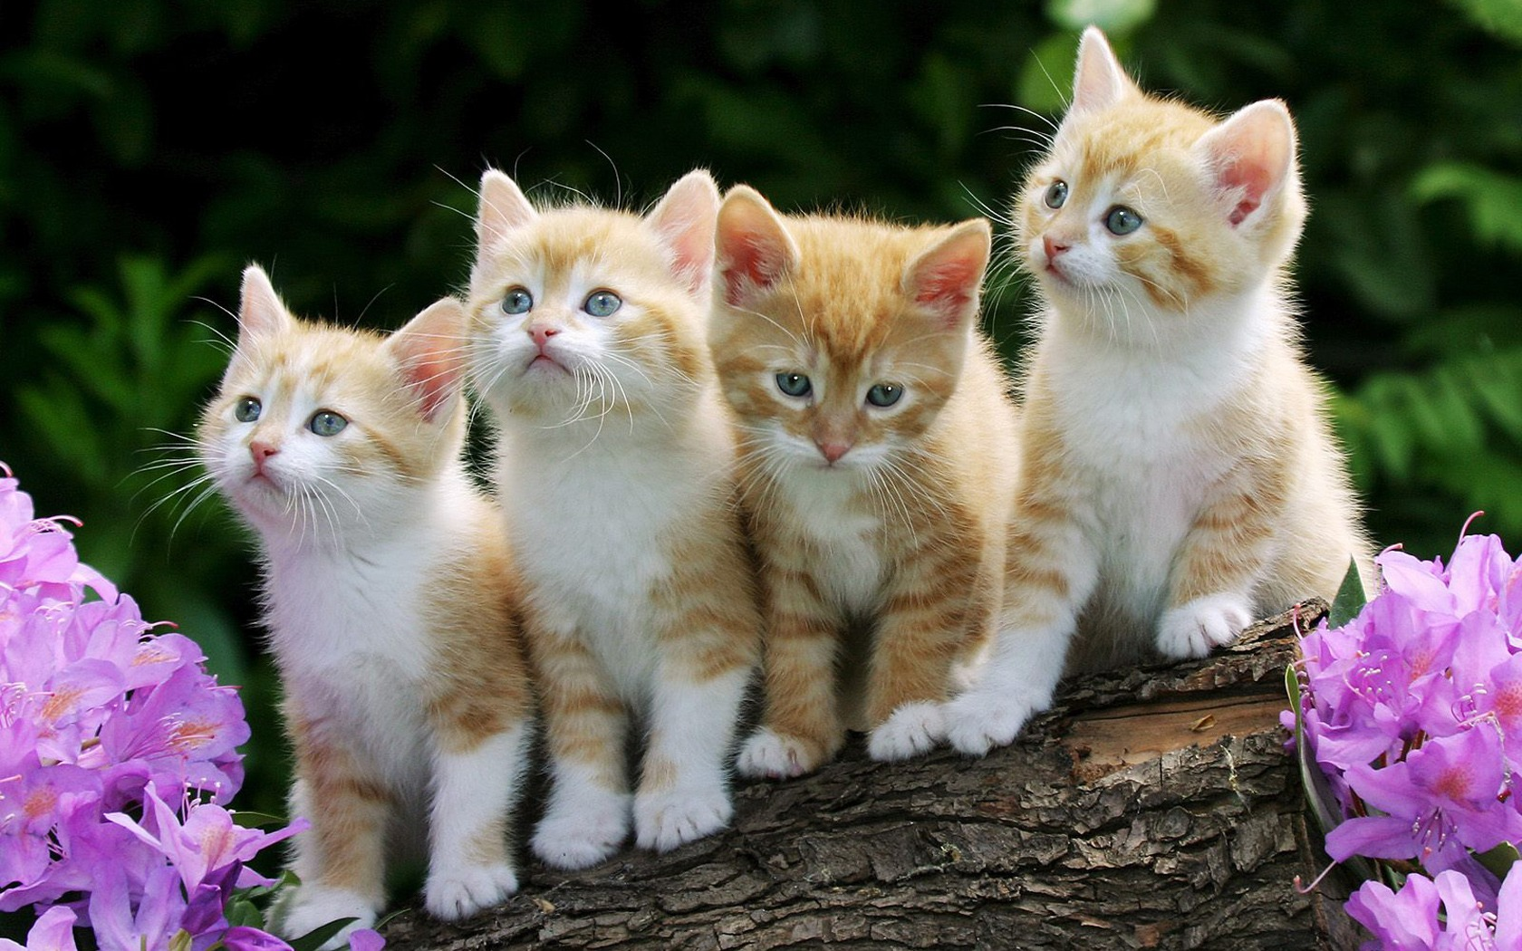
Cats facts

Slide 2
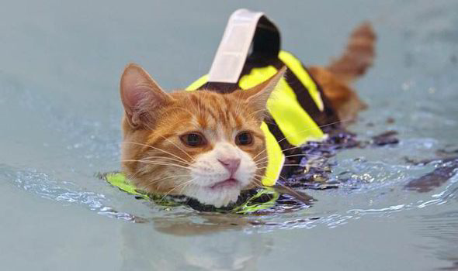
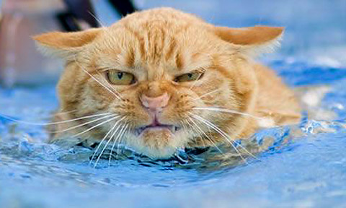
What cats don't like?
Cats don't like water they don't like getting wet

Slide 3
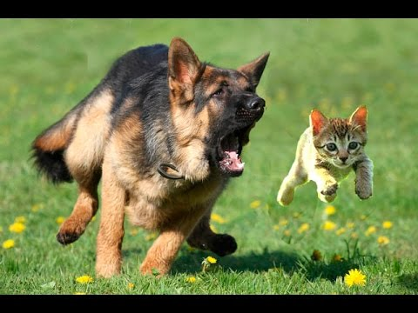
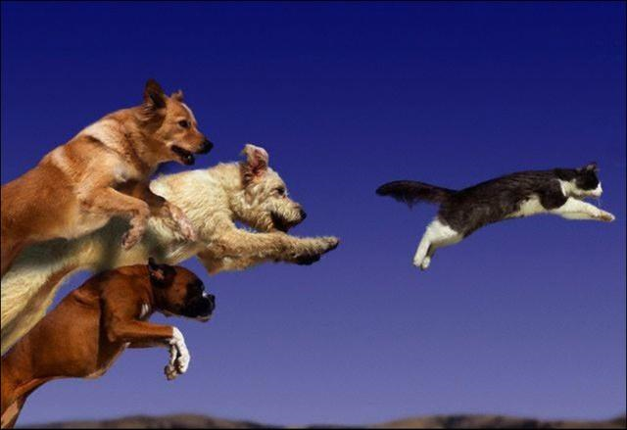
DOG CHASE!!!!
SOME CAT HATE GETTING CHASED

Slide 4

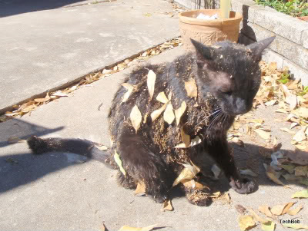
DIRTY CATS
Cats make toe prints on the floor
Should I have a
Bath??

Slide 5





my cat might ???????
My cat might follow me to school

Slide 6
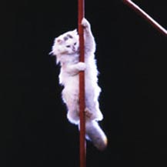
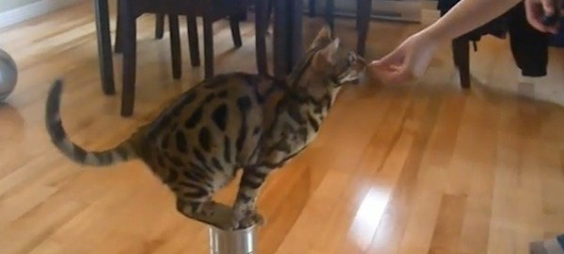

SOME CAT ARE SMART
Some cats can do tricks

Slide 7
SOME CAT ARE SMART
Some cats can do tricks

